Slide 1
Topic 17:
Remote Sensing
17.1 Production and use of X-rays
17.2 Production and uses of ultrasound
17.3 Use of magnetic resonance as an imaging technique

Slide 2
ULTRASOUND SCANNING

Slide 3
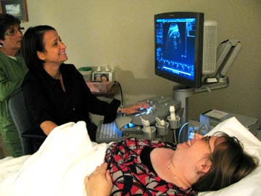
Ultrasound Scanning
Ultrasound scanning or ultrasonography is a medical imaging technique that uses high frequency sound waves and their echoes.
The technique is similar to the echolocation used by bats, whales and dolphins, as well as SONAR used by submarines.
SONAR: Sound Navigation and Ranging

Slide 4
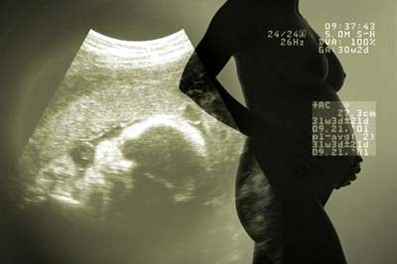
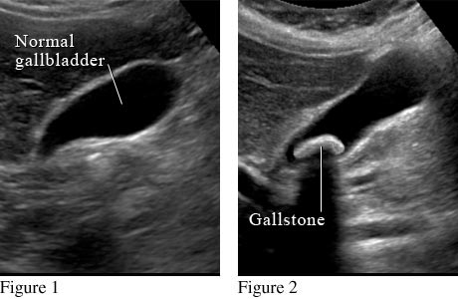

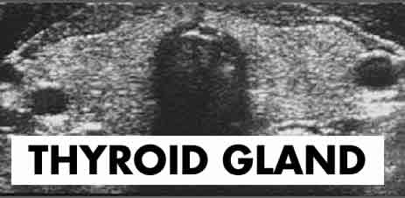
Some Applications
Ultrasound scan is popularly used to:
monitor fetus development
analysing abnormalities of the thyroid gland
detect stones in the gall bladder, kidneys and urinary system
Monitor fetus development
Detect stones

Slide 5
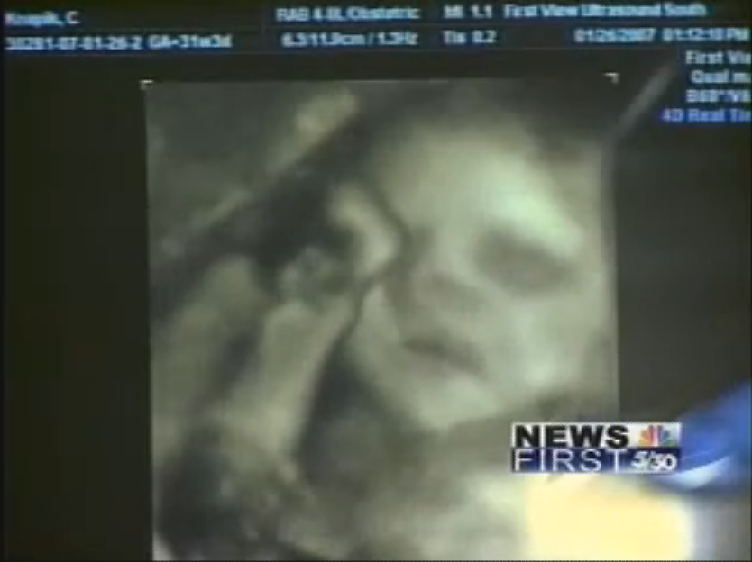
Ultrasound Scanning Demo
CLICK IMAGE
http://www.youtube.com/watch?v=ERTgbRnlAQw

Slide 6
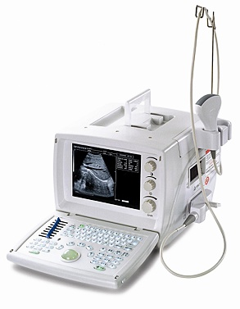
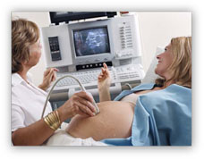
The Ultrasound Machine
A basic ultrasound machine has the following parts:
Transducer probe - probe that sends and receives the sound waves
Transducer pulse controls - changes the amplitude, frequency and duration of the pulses emitted from the transducer probe
Central processing unit (CPU) - computer that does all of the calculations and contains the electrical power supplies for itself and the transducer probe
Display - displays the image from the ultrasound data processed by the CPU
Other peripherals:
  Keyboard/cursor - inputs data and takes measurements from the display
  Disk storage device (hard, floppy, CD) - stores the acquired images
  Printer - prints the image from the displayed data

Slide 7
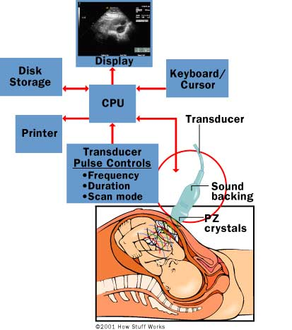
Block Diagram

Slide 8
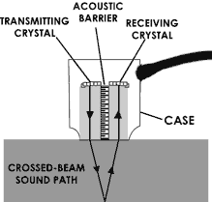
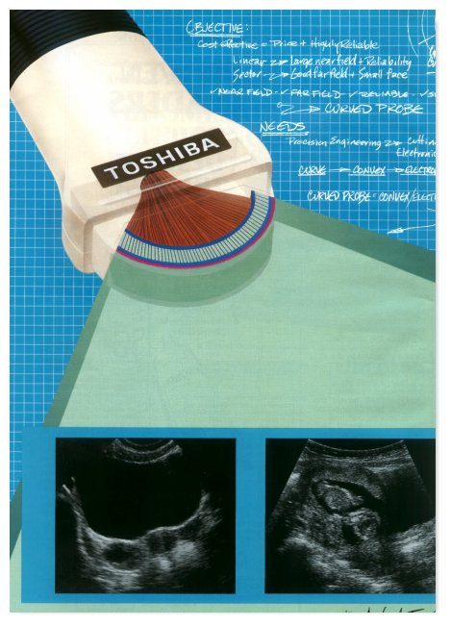
The Process
The transducer generates sound waves by using electrical potential to vibrate crystals within the transducer.
The transducer sends out sound waves in pulses.
Between pulses, it listens for echoes that are returning from structures within the body.
The ultrasound system produces an image based on the time it takes for sound waves to return to the transducer and the strength of those sound waves.
  Sound waves that take longer to return will show up as farther away in the image.
  Stronger sound waves will show up as brighter objects.

Slide 9
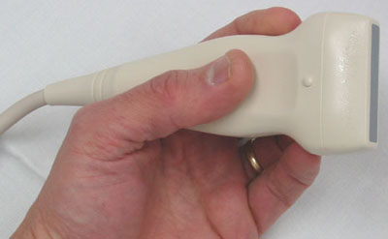
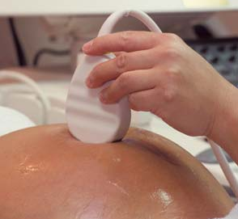
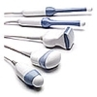
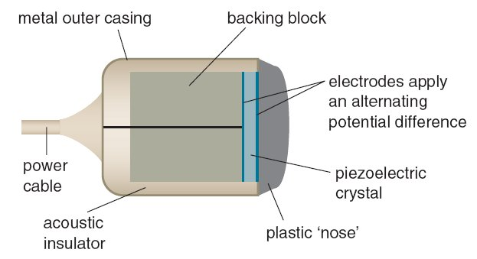
Structure of the Transducer Probe

Slide 10
The Transducer Probe
The transducer probe is the main part of the ultrasound machine.
The transducer probe makes the sound waves and receives the echoes. It is, so to speak, the mouth and ears of the ultrasound machine.
The transducer probe generates and receives sound waves using a principle called the piezoelectric (pressure electricity) effect, which was discovered by Pierre and Jacques Curie in 1880.
In the probe, there are one or more quartz crystals called piezoelectric crystals.
When a potential difference is applied between these crystals, they change shape rapidly.
The rapid shape changes, or vibrations, of the crystals produce sound waves that travel outward.
Conversely, when sound or pressure waves hit the crystals, they emit electrical pulses.
Therefore, the same crystals can be used to send and receive sound waves.
The probe also has a sound absorbing substance to eliminate back reflections from the probe itself, and an acoustic lens to help focus the emitted sound waves.

Slide 11
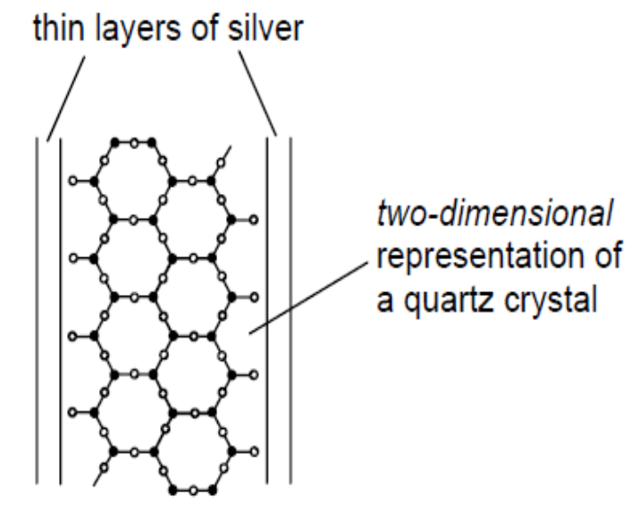
The Piezoelectric Transducer
The piezoelectric transducer is made up of a piece of quartz crystal with its two opposite sides coated with thin layers of silver to act as electrical contacts.

Slide 12
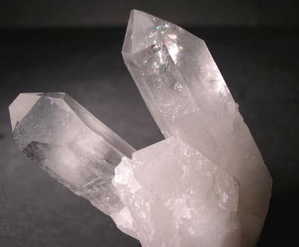
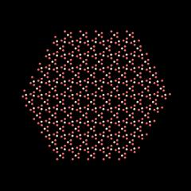
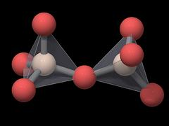
The Quartz Crystal
positively-charged silicon ion
negatively-charged oxygen ion
Quartz is made up of a large number of repeating tetrahedral silicate units. The positions of the oxygen links are not rigidly fixed in these units, or lattices, and since the oxygen ions are negatively charged, movement can be encouraged by applying an electric field.

Slide 13
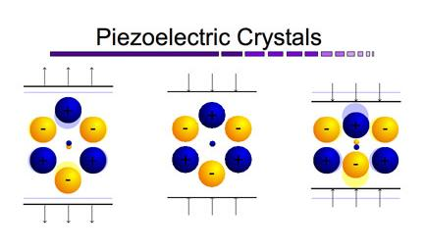
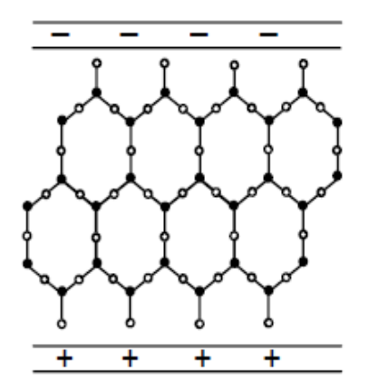
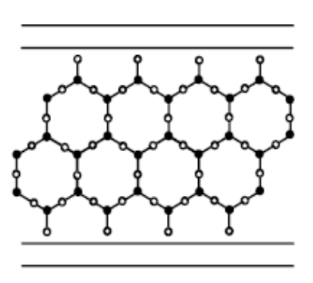
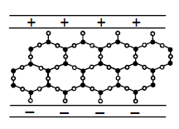
The Production of Sound Waves (1)
extended
unstressed
compressed
When the crystal is unstressed, the centres of charge of the positive and the negative ions bound in the lattice of the piezo-electric crystal coincide, so their effects are neutralised.
If a constant voltage is applied across the electrodes, the positive silicon ions are attracted towards the cathode and the negative oxygen ions towards the anode. This causes distortion of the silicate units. Depending on the polarity of the applied voltage, the crystal becomes either thinner or thicker as a result of the altered charge distribution.

Slide 14
The Production of Sound Waves (2)
extended
unstressed
compressed
An alternating voltage applied across the silver electrodes will set up mechanical vibrations in the crystal.
If the frequency of the applied voltage is the same as the natural frequency of vibration of the crystal, resonance occurs and the oscillations have maximum amplitude.
The dimensions of the crystal can be such that the oscillations are in the ultrasonic range (i.e. greater than 20 kHz), thus producing ultrasonic waves in the surrounding medium.

Slide 15
The Production of Electrical Pulses
extended
unstressed
compressed
Ultrasonic transducers can also be used as receivers.
When an ultrasonic wave is incident on an unstressed piezo-electric crystal, the pressure variations alter the positions of positive and negative ions within the crystal.
This induces opposite charges on the silver electrodes, producing a potential difference between them.
This varying potential difference can then be amplified and processed.

Slide 16
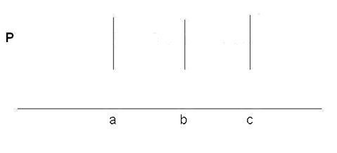
Ultrasound Imaging
Ultrasound imaging is performed by emitting a pulse, which is partly reflected from a boundary between two tissue structures, and partially transmitted. The reflection depends on the difference in impedance of the two tissues.
Reflection at tissue boundaries a, b and c.

Slide 17
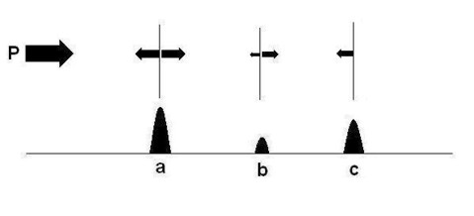
Ultrasound Imaging
An ultrasound pulse is emitted from the probe P.
Part of the pulse energy is reflected from the scatterer a, the rest is transmitted.
Part of the energy transmitted at a is reflected from b and the rest transmitted.
The energy transmitted at b will be reflected when it hits c.
When the pulse returns to P, the reflected pulse gives information of two measurements:
  The amplitude of the reflected signal,
  and the time it takes returning.
The time taken is dependent on the distance from the probe (twice the time the sound uses to travel the distance between the transmitter and the reflector, as the sound travels back and forth).
The amplitude indicate the amount of energy being reflected from each point.
  Thus, the incoming (incident) pulse at a has the full amplitude of P.
  At b, the incoming pulse is the pulse transmitted through a.
  At c, the incident pulse is the transmitted pulse from b.
  (In both cases minus further attenuation in the interval.)

Slide 18
Laws of Reflection & Refraction
Ultrasound obeys the same laws of reflection and refraction at boundaries as audible sound and light.
For an incident intensity I, reflected intensity I_{R} and transmitted intensity I_{T}, then from energy considerations,
I = I_{R} + I_{T}.

Slide 19
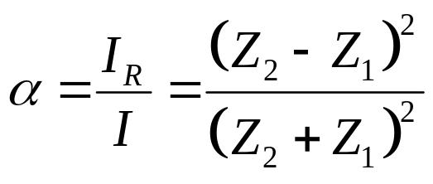
Acoustic Impedance
The relative magnitudes of the reflected and transmitted intensities depend not only on the angle of incidence but also on the acoustic impedance of the two media.
The specific acoustic impedance Z of a medium is the speed of sound in the material multiplies the density:
Z = ρ × c
The ratio I_{R} / I is known as the intensity reflection coefficient for the boundary and is usually given the symbol α

Slide 20
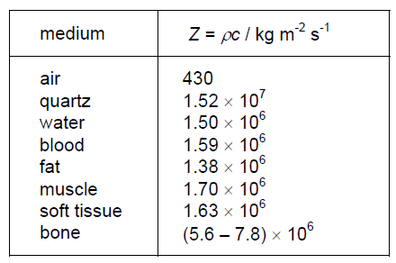
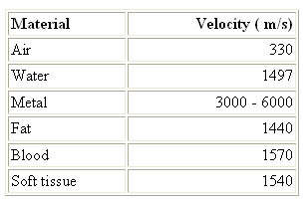
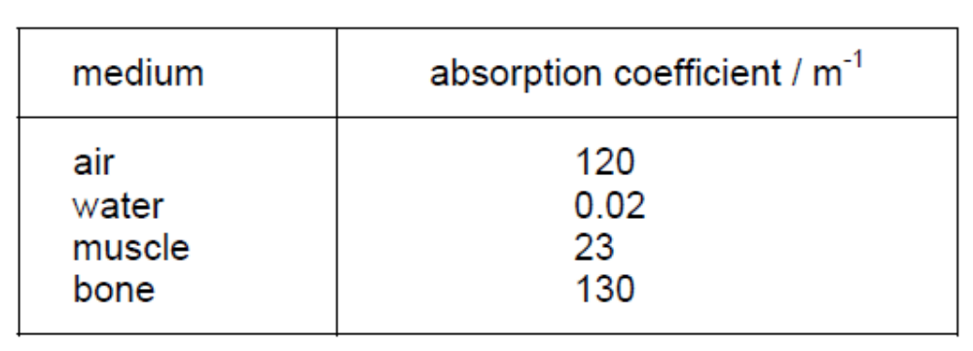
Velocity, Impedance
& Absorption Coefficient
The sound velocity in a given material is constant (at a given temperature), but varies in different materials:

Slide 21
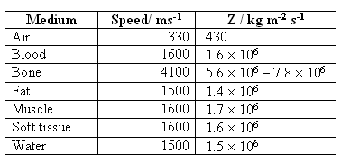
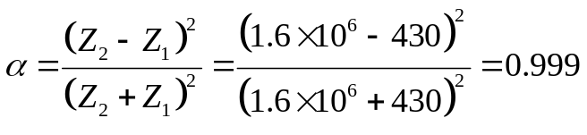
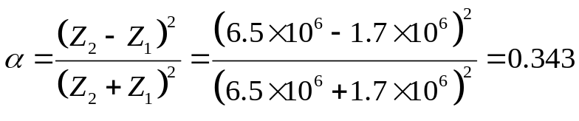
Example 1
Using the data in the table, calculate the intensity reflection coefficient for a parallel beam of ultrasound incident normally on the boundary between:
(a) Air and soft tissue
(b) Muscle and bone that has a specific acoustic impedance of 6.5 × 10⁶ kg m⁻² s⁻¹
Solution:
(a) (b)

Slide 22
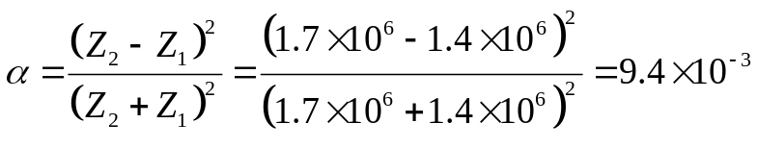
Example 2
Using the data in the table:
(a) Suggest why, although the speed of ultrasound in blood and muscle is approximately the same, the specific acoustic impedance is different.
(b) Calculate the intensity reflection coefficient for a parallel beam of ultrasound incident normally on the boundary between fat and muscle.
Solution:
(a) Their density is different, muscle has a higher density and hence a higher specific acoustic impedance.
(b)

Slide 23
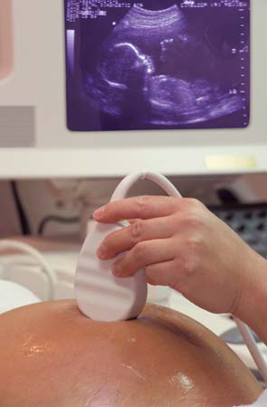
Use of Gel
When in use, the transducer is placed in contact with the skin, with a gel acting as a coupling medium.
The gel reduces the size of the impedance change between boundaries at the skin and thus reduces reflection at the skin, enabling more waves to enter the body.

Slide 24
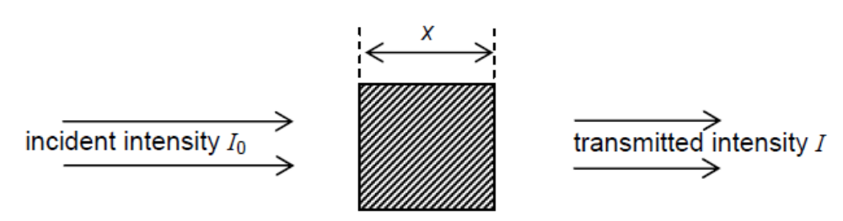
Absorption of Energy
A second factor that affects the intensity of ultrasonic waves passing through a medium is absorption.
As a wave travels through a medium, energy is absorbed by the medium and the intensity of a parallel beam decreases exponentially. The temperature of the medium rises.
The intensity I of the beam after passing through the medium is related to the incident intensity by the expression
I = I₀ e^{-kx}
where k is a constant for the medium referred to as the absorption coefficient. This coefficient is dependent on the frequency of the ultrasound.

Slide 25
Example 3
A parallel beam of ultrasound is incident on the surface of a muscle and passes through a thickness of 3.5 cm of the muscle. It is then reflected at the surface of a bone and returns through the muscle to its surface. Using data from the tables, calculate the fraction of the incident intensity that arrives at the surface of the muscle.
Solution:
The beam passes through a total thickness of 7.0 cm of muscle.
Therefore, I = I₀ e^{-kx} = I₀ e^{-0.23×7.0} = 0.20 I₀
It is obtained from the previous example,
Fraction of sound reflected at the muscle-bone interface = 0.34
Therefore fraction received back at surface = 0.34 × 0.20 = 0.068 = 1/15

Slide 26
Practice 4
A parallel beam of ultrasound passes through a thickness of 4.0 cm of muscle. It is then incident normally on a bone having a specific acoustic impedance of 6.4 × 10⁶ kg m⁻² s⁻¹. The bone is 1.5 cm thick. Using data from the table, calculate the fraction of the incident intensity that is transmitted through the muscle and bone.
Answer:

Slide 27
Significance of Absorption
Absorption has raised two important considerations:
The heating of the tissue is the safety limitation on ultrasound equipment. The absorbed energy has to remain within limits that does not heat the tissue to dangerous temperatures. The absorption can be calculated, and in commercial equipment today, the limitation is imposed in the limitation of the total energy that can be transmitted.
The absorption is the limiting factor for the depth penetration of the beam, i.e. the depth to which the beam can be transmitted.
A side benefit:
The heating effect caused by ultrasound of suitable frequencies is, in fact, used in physiotherapy to assist recovery from sprained joints.

Slide 28
Factors Affecting Absorption
Absorption is dependent on:
The density of the tissue. The higher the density, the more absorption.
  Thus the attenuation is:
  fluid < fat < muscle < fibrous tissue < calcifications and bone.
The frequency of the ultrasound beam. The higher the frequency, the more absorption.
  Thus, the desired depth to be imaged, sets the limit for how high frequency that can be used.
  As can be seen, penetration might be increased by increasing the transmitted energy, but this would increase the total absorbed energy as well, which has to stay below the safety limits.
  In practice, a lower frequency (e,g, 3.5 MHz) is used for deeper penetration and a higher frequency (e.g 7.5 MHz) for superficial areas. (Higher frequency used will give image of better resolution)

Slide 29
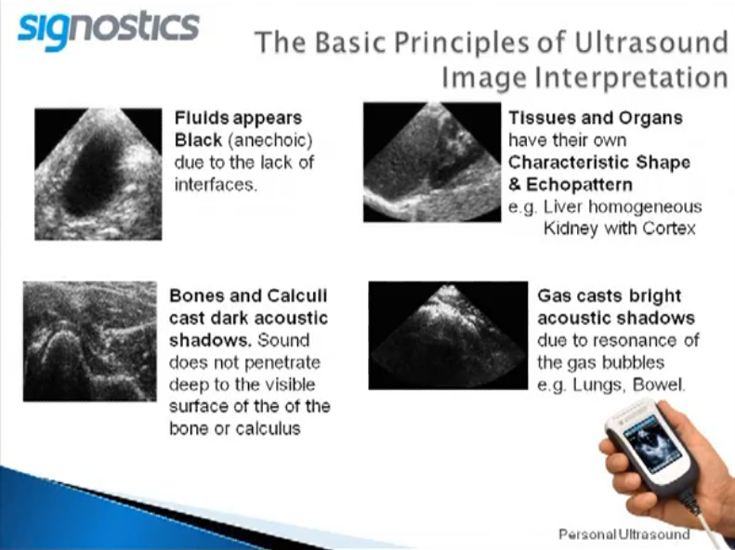
Images

Slide 30
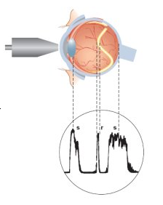
A-scans
A-scans are used to measure distances. A transducer emits an ultrasonic pulse and the time taken for the pulse to bounce off an object and come back is graphed in order to determine how far away the object is. A-scans only give one-dimensional information and therefore are not useful for imaging.

Slide 31
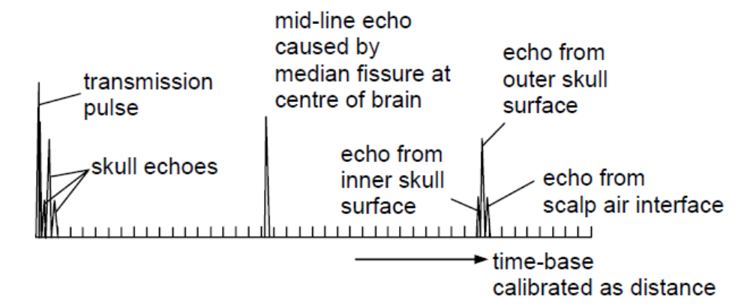
The A-scan System (1)
The A-scan system basically measures the distance of different boundaries from the transducer, with the transducer held in one position.
A short burst of ultrasound is transmitted to the body through the coupling medium.
At each boundary between different media in the body, some ultrasound is reflected and some is transmitted.
The reflected pulse is picked up by the transducer which now acts as a receiver. The signal is amplified and displayed on a cathode-ray oscilloscope (c.r.o.).
The reflected pulse also meets boundaries as it returns to the transducer. This causes some of the energy of the reflected pulse to be lost and energy is also lost due to absorption in the media.

Slide 32
The A-scan System (2)
Consequently, echoes from deeper in the body tend to be of lower intensity. To compensate for this, the later an echo is received at the transducer, the more it is amplified before display on the c.r.o.
A vertical line appears on the screen each time an echo is received.
The time-base on the X-plates is adjusted so that all of the reflections are seen on the screen for one scan (pulse).
The distance between boundaries can be calculated if the speed of ultrasound in the various media is known. An example of an A-scan for the brain is shown in diagram above.

Slide 33
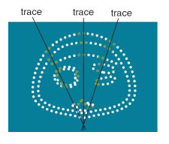
B-scans
B-scans can be used to take an image of a cross-section through the body. The transducer is swept across the area and the time taken for pulses to return is used to determine distances, which are plotted as a series of dots on the image. B-Scans will give two-dimensional information about the cross-section.

Slide 34
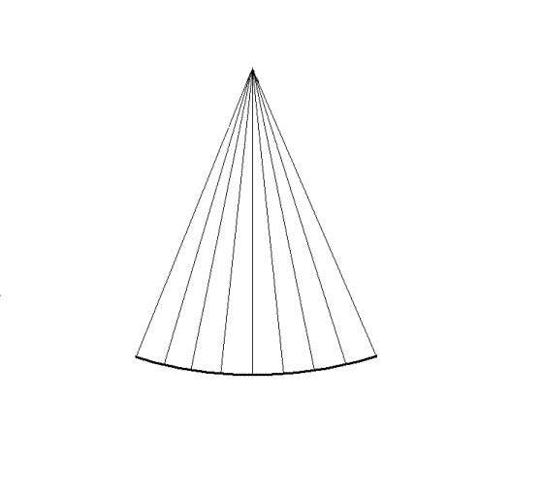
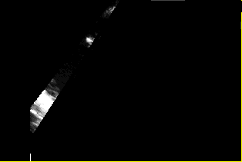
The B-scan System
The B-scan technique basically combines a series of A-scans, taken from a range of different angles, to form a two-dimensional picture. As before, each A-scan corresponds to a single ultrasound pulse being emitted by the transducer and producing a series of reflected pulses from boundaries within the body.
The ultrasound probe for a B-scan consists of a series of small crystals, each having a slightly different orientation. The signals received from the crystals in the probe are processed by a computer. Each reflected pulse is shown as a bright spot in the correct orientation of the crystal on the screen of a c.r.o.
Consequently, the completed pattern of spots from all the crystals in the probe builds up into a two-dimensional representation of the boundary positions in the body being scanned. This image may be photographed or stored in the computer memory.

Slide 35
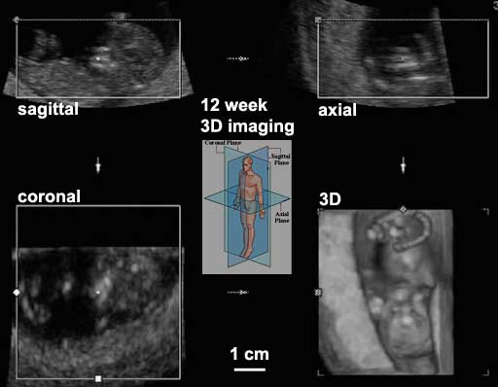
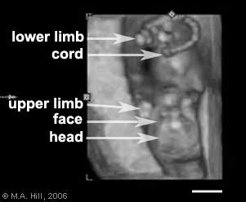
3-D Images
A 3-D ultrasound uses the same principle as a 2-D ultrasound. The difference is that the sound waves are emitted from all angles. The example above shows a 12 week fetal ultrasound images in the sagittal, axial and coronal planes that are used by the computer to generate the final 3D image in the lower right.

Slide 36
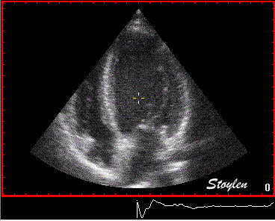
4-D Images
A 4-D ultrasound uses the 3-D technology, but added in the time dimension. It displays a series of 3-D images over a period of time, thus giving it motion. These are generally short clips, and can show a heart beating or a baby yawning.

Slide 37
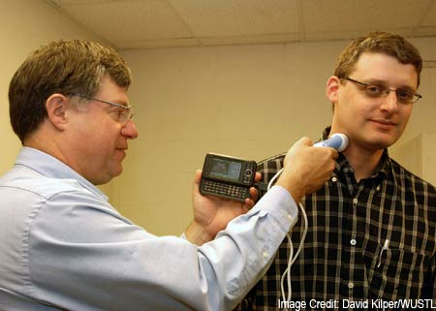
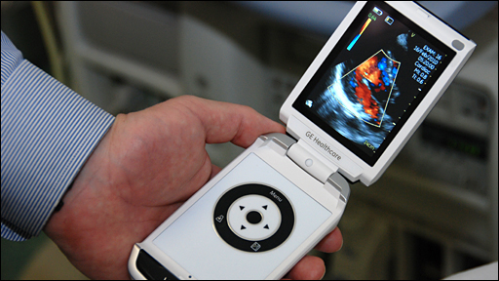
Advantages of Ultrasound Scans
Can make images of soft tissues and to differentiate clearly between solids and fluid filled spaces.
It makes diagnosis easy as it gives instant images so that the most useful can be selected by the operator.
Allows for the structure of the organs to be detected as well as to determine how the organ is functioning, to some extent.
There are no known side effects of this method, and the process does not cause any discomfort to the patient.
The relatively small size of the scanners makes it possible to carry it anywhere.

Slide 38
Weaknesses of Ultrasound Scanning
The basic ultrasound devices cannot penetrate bones; but ongoing programs are geared towards making it possible for bone imaging through ultrasound technology.
When a gas exists between the device and the target organ, there is a lot of difficulty using ultrasound. This makes scanning of certain organs like the pancreas almost impossible.
Ultrasound cannot penetrate deep into the body; this makes diagnosing organs that are deep in the body very difficult. The method depends highly on the operator who should be highly skilled and experienced in order to produce the quality images needed for the right diagnosis.
There are some concerns over the development of heat during scanning
  tissues or water will absorb the energy which increases their temperature locally.
  the raised temperature may cause formation of bubbles (cavitation) when dissolved gases come out of solution due to the local heat.

Slide 39
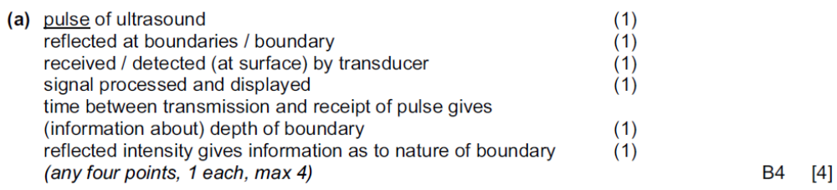
Ultrasound (P4-June 2009) (1/3)
(a) Explain the main principles behind the use of ultrasound to obtain diagnostic information about internal body structures. [4]
Solution:

Slide 40
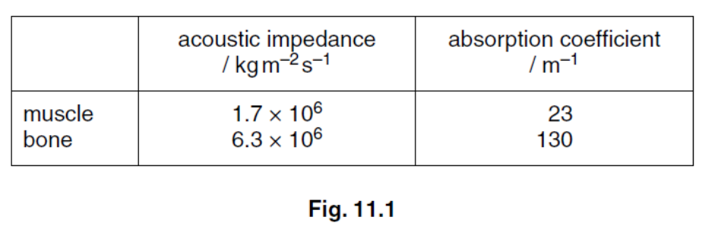
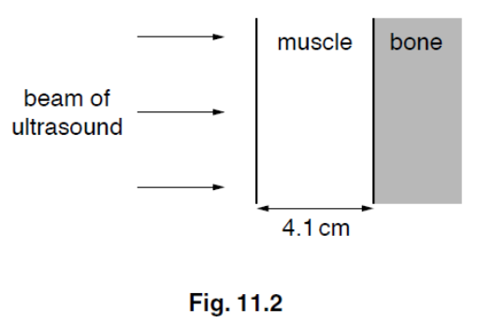
Ultrasound (P4-June 2009) (2/3)
(b) Data for the acoustic impedances and absorption (attenuation) coefficients of muscle and bone are given in Fig. 11.1.
The intensity reflection coefficient is given by the expression
(Z₂ – Z₁)²
(Z₂ + Z₁)² .
The attenuation of ultrasound in muscle follows a similar relation to the attenuation of X-rays in matter. A parallel beam of ultrasound of intensity I enters the surface of a layer of muscle of thickness 4.1 cm as shown in Fig. 11.2.
The ultrasound is reflected at a muscle-bone boundary and returns to the surface of the muscle. Calculate
(i) the intensity reflection coefficient at the muscle-bone boundary, [2]
(ii) the fraction of the incident intensity that is transmitted from the surface of the muscle to the surface of the bone, [2]
(iii) the intensity, in terms of I, that is received back at the surface of the muscle. [2]

Slide 41
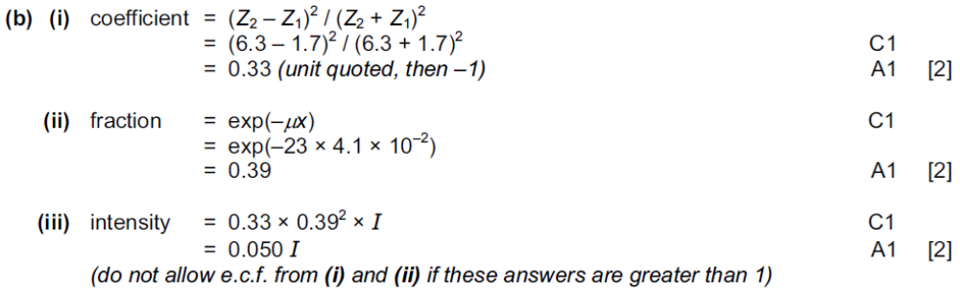
Ultrasound (P4-June 2009) (3/3)
Solution:

Slide 42
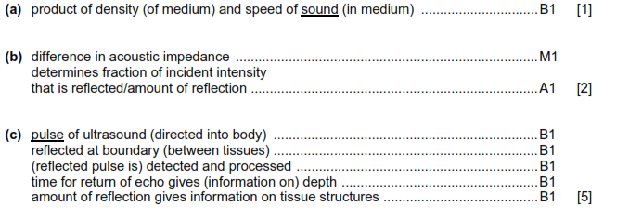
Ultrasound (P4-Nov 2007)
(a) State what is meant by acoustic impedance. [1]
(b) Explain why acoustic impedance is important when considering reflection of ultrasound at the boundary between two media. [2]
(c) Explain the principles behind the use of ultrasound to obtain diagnostic information about structures within the body. [5]
Solution:

Slide 43

Ultrasound (P4 June 11)

Slide 44



Answer

Slide 45

Ultrasound (P4 Nov 10)

Slide 46



Slide 47

Answer

Slide 48
The End

